Slide 1
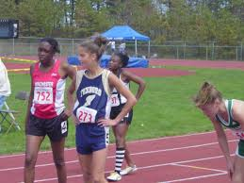
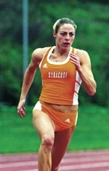
Alison Culley Ellsworth Foxborough H.S. 1998
Here Alison is pictured in her early Hockomock League competition days where she went undefeated for 5 years in a row starting in 8th grade in the 100, 200 and 400. Her high school PR’s are:
100m = 11.8
200m = 24.44
300m = 39.45
400m = 56.53
5X Boston Globe and Herald All Star and Runner of the Year in 1998.
While at Syracuse she owned or was part of seven school records. She was selected at the captain of the track team. She was a several times Big East and ECAC champion. Her PR’s were:
55m = 7.02
60m = 7:53
100m = 11.64
200m = 23.33 Standing ‘Cuse Record
4x400 = 3:37.02 Standing ‘Cuse Record
DMR = 11:56.0 Standing’ Cuse Record.

Slide 2
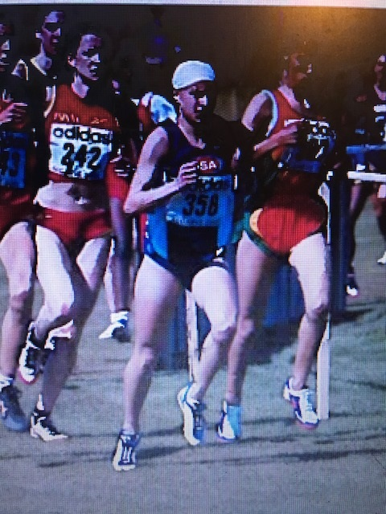
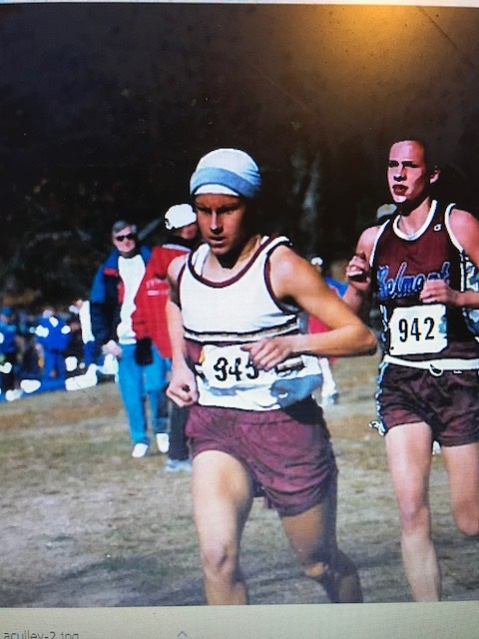
Sheela Gyanvati Agrawal Joseph Case H.S. 1999
While at Case High School Sheela finished 2nd at all state cross country meet, both times to Shalane Flanagan.
2X Globe Runner of the year
2X Footlocker qualifier.
High school All-American
Dartmouth Relays 1 mile Champ in 4:59.46
Competed in Millrose Mile. State record in the 2 mile at 10:19 and
Mile record at 4:46.0
While at Duke University she was selected as a:
1st Team Verizon All-ACADEMIC TEAM
A 3X All-East
A 3X All-ACC
A 3X All-American
Held the Duke school records in the 3k and 5K
College PR’s:
1-Mile = 4:40.58
3K = 9:23.89
5K = 16:29

Slide 3
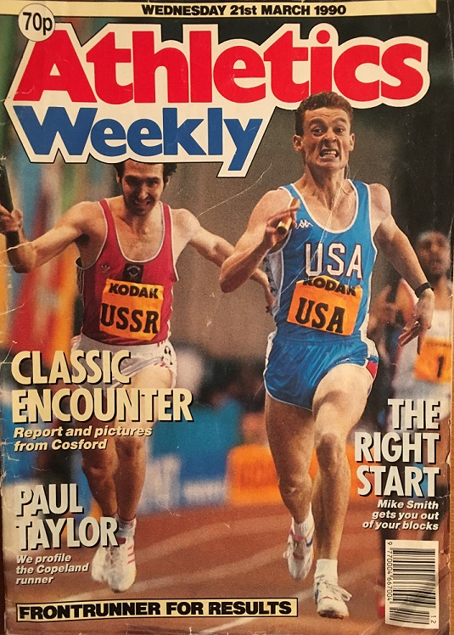
Brian Crossman Saint Dominic Savio High School 1984
While at Dom Savio Brian won the 1984 indoor Class C 600 yard run the outdoor Class C 400 meter and the New England 400 meter Championship. His High School PR’s include:
600 yard = 1:13.3
400 meter = 48.6
While at Fitchburg State Brian was a:
4X New England Champion
13X NCAA Div. II All-American.
NCAA Div. III national champion in 1986 and 1988. In both those years his times were National Records and he became the 1st Div. III Athlete to break 48 seconds
Collegiate PR’s:
200 meters = 21.38
400 meters = 47.13
600 yards = 1:10.19
Brian competed internationally after college. His indoor PR’s:
200 meters = 21.91
400 meters = 47.18
500 meters = 1:02.15
Outdoor RR’s:
100 meters 10.65
200 meters 21.38
400 meters 46.60

Slide 4
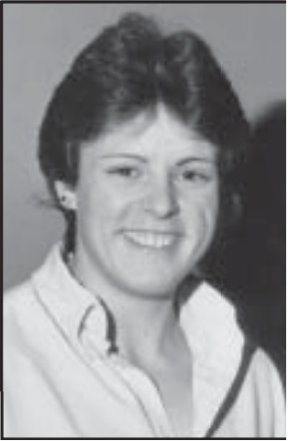
Pam Hall Grady Weston High School 1980
While at Weston High School Pam was a 5X Globe All Scholastic and Globe “Athlete of the Year” her senior year. She was a 2X outdoor state Champion a 2X New England Champ and a 3X indoor state champion. Pam Also finished 3rd at the U.S. Junior National meet in 1980.
Her High School PR’s are:
Shot Put (8 lb.) = 47’5”
Shot Put (4k) = 45’1”
Discus = 124’7”
Javelin = 123’9”
While at the University of Miami Ohio
Hall finished her career as Miami's all-time point scorer for women's track and field with 319 points and currently ranks among the Red and White's top 15 career point scorers.
Was a 2X All-conference in the Shot
Was a conference scorer for Miami all four years.
She also was one of the league's top discus throwers.
Inducted in to Miami Ohio’s Hall of Fame in 2007
College PR’s:
4k Shot = 47’1.5”
Javelin = 128’11”

Slide 5
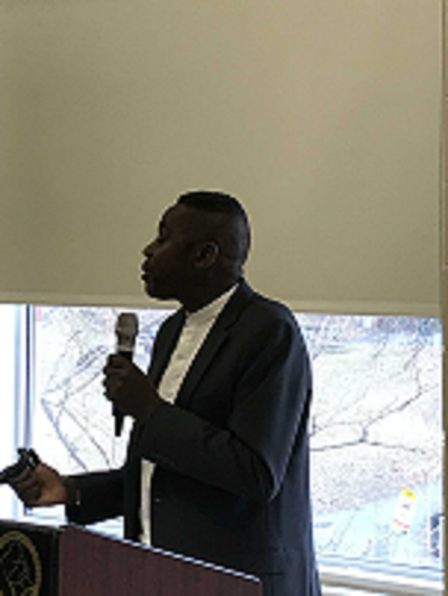
Roberto Cooper Rindge Technical High School 1976
A combination of explosiveness and endurance defines Roberto Cooper while at Rindge Tech. He finished 3rd at the All-State XC Meet ran the 800, 1000, 1-mile and 2-mile. Yet his best events were the jumps. At the indoor All-State meet meet his Jr. Year he was 2nd in the High Jump and 2nd in the 2-Mile. At the outdoor All-State meet his Sr. Year he was 2nd in the 800 w/ a time of 1:57.2 and won the High Jump at 6’10.25”
While at Adelphi University he set and currently still holds their school records in the indoor High Jump at 6’10” and outdoor school record with a jump of 7’2”.
Interestingly he still holds the #10 all time for 5 miles at Adelphi with a time of 27:29.
He was selected as an All-American and has been inducted into Adelphi’s Athlete Hall of Fame.

Slide 6
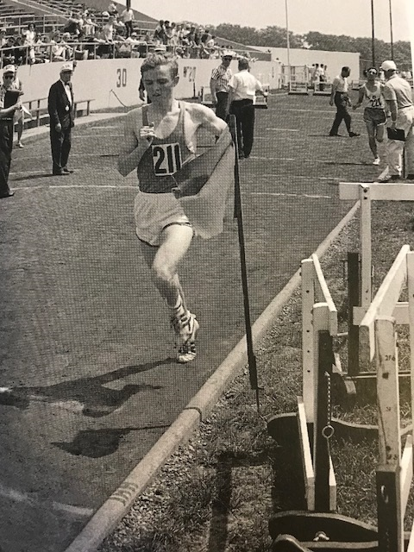
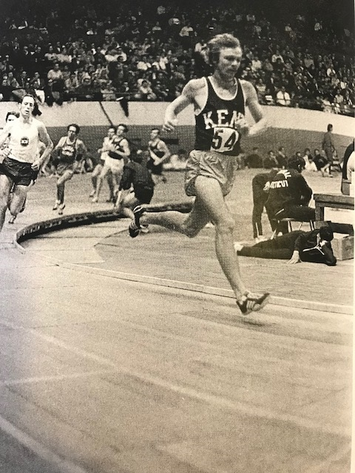
Ed Norris Brockton High School 1966
While at Brockton High School Ed won the BAA High School Indoor Mile at the Boston Garden, He was the Class A Indoor 2-Mile Champion setting a meet record, Eastern State’s Indoor 2-Mile champ setting a National HS Flat Floor Record, he was the Class A outdoor 2-mile champion with a meet record and the State Meet Outdoor 2-Mile champ setting another meet record. High School PR’s:
2 mile = 9:08.8
3 mile run = 14:17
5.5 mile run = 26:41
While at Kent State Ed won many prestigious races such as the
New England 25K road race, the Drake Relays 2 mile, the Ohio University Relays 5k, Mid American 3 mile, and the Western Michigan 2 mile.
Ed’s colligate PR’s are:
2 Mile = 8:47.4
3 Mile = 13:35
6 Mile = 28:59

Slide 7
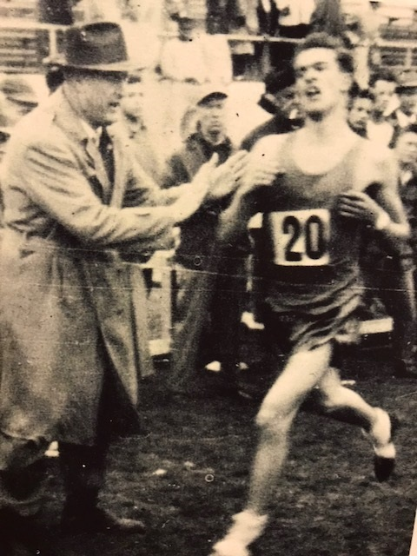
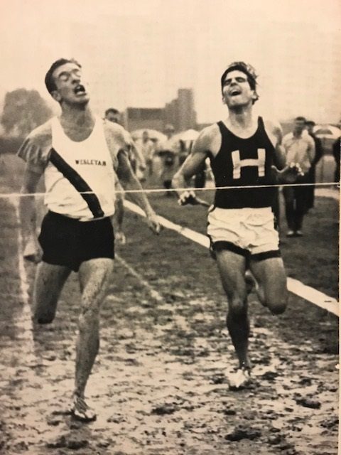
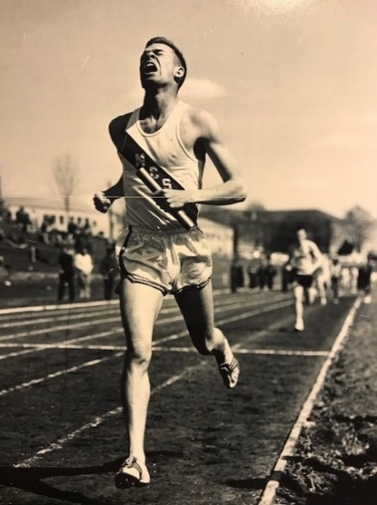
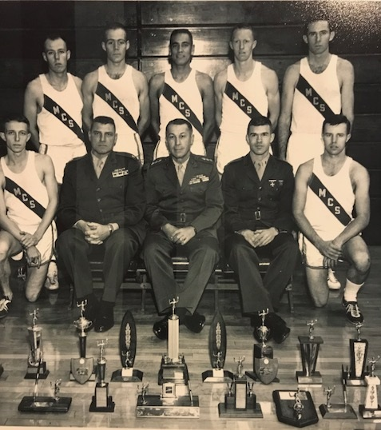
Stephen ‘Spike’ Paranya: Lexington H.S. 1957
Pictured here is Spike Paranya as he sets another record at White Stadium in the State meet in XC.
His PR’s were:
1 Mile = 4:27.0
1000 Yards = 2:19.2
880 Yards = 1:53.4
440 Yards = 48.7
220 Yards = 22.4
Long Jump = 21’6”
“1957 ALL AMERICAN TEAM FOR THE 880.
At Wesleyan College Spike would collect 5 New England and IC4A Championships. Here he wins the IC4A Championship in the mile over Favored Mark Mullins.
PR’s at Wesleyan:
880 = 1:52.4
1 Mile = 4:07.0
Spike would reach the rank of Lieutenant in the United States Marine Corps where he also competed and coached the USMC Track Team. Pictured on the far left is Spike anchoring the SMR and bringing home the Gold at the USMC Quantico Relays. Spike’s team consisted of such stars like Larry Rawson and Billy Mills who would go on to win a Gold Medal at the 1964 Olympic Games.

